Slide 1
SUMMARY
The <table> element is used to add tables to a
web page.
Notes:
Clicks: Load individual bullets

Slide 2
SUMMARY
A table is drawn out row by row. Each row is created with the <tr> element.
Notes:
Clicks: Load individual bullets

Slide 3
SUMMARY
Inside each row are cells represented by the <td> element (or <th> if it is
a header).
Notes:
Clicks: Load individual bullets

Slide 4
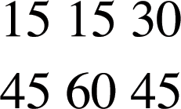
BASIC TABLE STRUCTURE
<table> <tr> <td>15</td> <td>15</td> <td>30</td> </tr> <tr> <td>45</td> <td>60</td> <td>90</td> </tr> </table>
Notes:
Explain: Tables are drawn out one row at a time.

Slide 5
BASIC TABLE STRUCTURE
Used to create tables
<table> <tr> <td>15</td> <td>15</td> <td>30</td> </tr> <tr> <td>45</td> <td>60</td> <td>90</td> </tr> </table>

Slide 6
BASIC TABLE STRUCTURE
Table Row indicates the start of each row.
<table> <tr> <td>15</td> <td>15</td> <td>30</td> </tr> <tr> <td>45</td> <td>60</td> <td>90</td> </tr> </table>
Notes:
Explain: The "tr" in the <tr> tag stands for "table row".

Slide 7
BASIC TABLE STRUCTURE
Table Data represents each cell.
<table> <tr> <td>15</td> <td>15</td> <td>30</td> </tr> <tr> <td>45</td> <td>60</td> <td>90</td> </tr> </table>
Notes:
Explain: The "td" in the <td> tag stands for "table data".

Slide 8
TABLE HEADINGS
Used to represent the heading for a column or row.
<table> <tr> <th></th> <th>Saturday</th> <th>Sunday</th> </tr> <tr> <th>Tickets sold</th> <td>120</td> <td>135</td> </tr> </table>
Notes:
Explain: You need to show tags for cells that have no data. For example, this table shows an empty cell on the first <th> element.

Slide 9
TABLE HEADINGS
Used to represent the heading for a column or row.
<table> <tr> <th></th> <th>Saturday</th> <th>Sunday</th> </tr> <tr> <th>Tickets sold</th> <td>120</td> <td>135</td> </tr> </table>

Slide 10
SUMMARY
You can make cells of a table span more than one row or column using the rowspan and colspan attributes.
Notes:
Clicks: Load individual bullets

Slide 11
SPANNING COLUMNS
Colspan Attribute indicates how many columns that cell should
run across.
... <tr> <th>Monday</th> <td colspan="2">Geography</td> <td>Math</td> <td>Art</td> </tr> ...

Slide 12
SPANNING ROWS
Rowspan Attribute indicates how many rows a cell should
span down.
... <tr> <th>6pm - 7pm</th> <td rowspan="2">Movie</td> <td>Comedy</td> <td>News</td> </tr> <tr> <th>7pm - 8pm</th> <td>Sport</td> <td>Current Affairs</td> </tr>

Slide 14
SUMMARY
For long tables you can split the table into a <thead>, <tbody>, and <tfoot>.
Notes:
Clicks: Load individual bullets

Slide 15
LONG TABLES
thead=header grouping tbody=body grouping
tfoot=footer grouping
<thead> <tr> <th>Date</th> <th>Income</th> <th>Expenditure</th> </tr> </thead> <tbody>...</tbody> <tfoot>...</tfoot>
Notes:
Explain: The <thead>, <tbody>, and <tfoot> tags can be used to hold heading, body, and footer information in a long table. For example, it can be used to put a heading and footer on every page of a long table and also to style contents differently than other parts of the table.

Slide 16
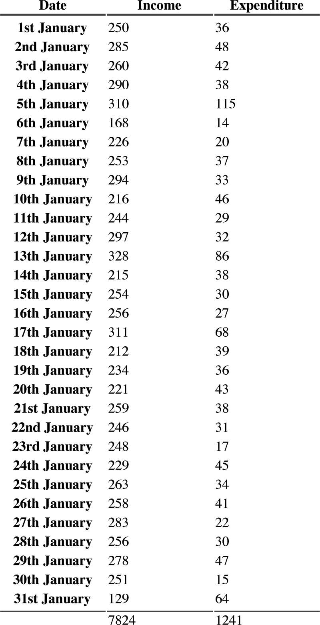

Slide 17
