Slide 1
LIST STYLES
UNORDERED
ORDERED
none
decimal
1 2 3
disc
decimal-leading-zero
01 02 03
circle
lower-alpha
a b c
square
upper-alpha
A B C
lower-roman
i. ii.
upper-roman
I II III
Notes:
Fade in: selected possible values

Slide 2
LIST-STYLE-TYPE
none, disc (•), circle (°), square, decimal (1), decimal-leading-zero (01), lower alpha (a), upper-alpha (A), lower-latin (a), upper-latin (A), lower-roman (iv), upper-roman (IV), lower-greek (ß)
ol { list-style-type: lower-roman;}

Slide 3
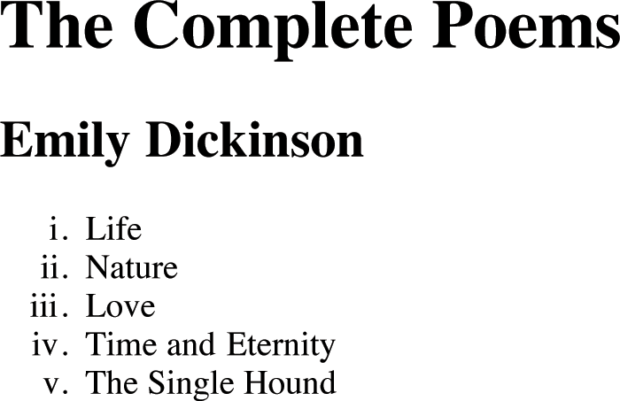

Slide 4
LIST-STYLE-IMAGE
Images for bullets
ul { list-style-image: url("star.png");}
li { margin: 10px 0px 0px 0px;}

Slide 5
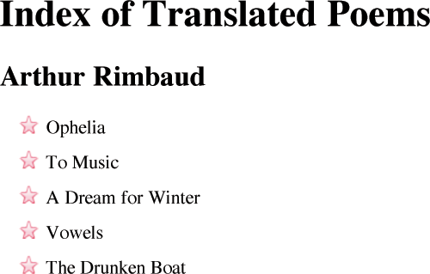

Slide 6
LIST-STYLE-POSITION
Positioning the marker
inside, outside
ul { width: 250px;} li { margin: 10px;} ul.illuminations { list-style-position: outside;} ul.season { list-style-position: inside;}

Slide 7
LIST-STYLE-POSITION
Positioning the marker
ul { width: 250px;} li { margin: 10px;} ul.illuminations { list-style-position: outside;} ul.season { list-style-position: inside;}
Notes:
Marker appears to the left of text by default.

Slide 8
LIST-STYLE-POSITION
Positioning the marker
ul { width: 250px;} li { margin: 10px;} ul.illuminations { list-style-position: outside;} ul.season { list-style-position: inside;}
Notes:
The marker sits inside the text - which is indented - by default.

Slide 9
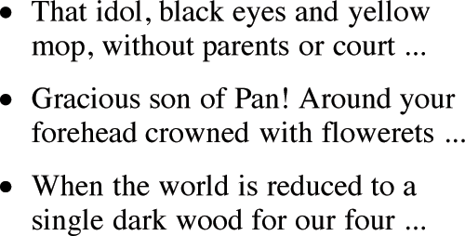
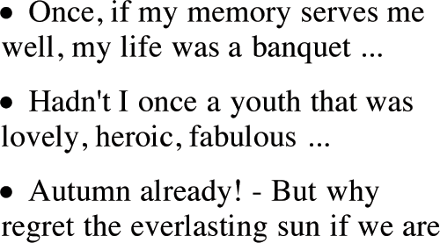

Slide 10
LIST-STYLE SHORTHAND
position, type, image
ul { list-style: inside circle; width: 300px;} li { margin: 10px 0px 0px 0px;}

Slide 11
LIST-STYLE SHORTHAND
list-style-position
ul { list-style: inside circle; width: 300px;} li { margin: 10px 0px 0px 0px;}

Slide 12
LIST-STYLE SHORTHAND
list-style-type
ul { list-style: inside circle; width: 300px;} li { margin: 10px 0px 0px 0px;}

