Slide 1
FOLDER STRUCTURE
A folder structure for a simple website has the main page (index.html) and other html files in the root folder along with the images folder.

Slide 2
NAVIGATION WITH LINKS
It is important to make sure users can identify where the links are located, often through color.
Users should know what page they are on and where they can go.
Good navigation is a tool that gives users a sense of place. Bad navigation leaves users lost and unsure how to proceed.

Slide 3
WRITING LINKS OR HYPERLINKS
ANCHOR
ELEMENT
<a href="http://www.imdb.com">IMDB</a>
HYPERTEXT
REFERENCE
ATTRIBUTE
Notes:
Click: Value of the href attribute is highlighted
- Explain that this is the 'value' of the href attribute
Click: Clickable area is highlighted (what the user sees)

Slide 4
WRITING LINKS
THE PAGE THE LINK TAKES YOU TO
<a href="http://www.imdb.com">IMDB</a>
Notes:
Click: Value of the href attribute is highlighted
- Explain that this is the 'value' of the href attribute
Click: Clickable area is highlighted (what the user sees)

Slide 5
WRITING LINKS
THE PAGE THE LINK TAKES YOU TO
<a href="http://www.imdb.com">IMDB</a>
THE TEXT THE USER CLICKS ON
The text shown as the link should be descriptive
Notes:
Click: Value of the href attribute is highlighted
- Explain that this is the 'value' of the href attribute
Click: Clickable area is highlighted (what the user sees)

Slide 6
ABSOLUTE URLS
Used when pointing to a document out on the Web.
Notes:
Shows the same directory structure as previous slide, but this time shows the relative URL
Click: Same folder - from music home page to music reviews page
Click: Child - from main home page to music listings page
Click: Parent - from music listings to main home page
Click: Grandchild - from main home page to DVD reviews page
Click: Grandparent: from DVD reviews to main home page

Slide 7

ABSOLUTE URL
Linking to other websites.
<a href="http://www.empireonline.com"> Empire</a>
Browsers display linked text as blue and underlined by default. Visited links display in purple.

Slide 8
RELATIVE URLS
Used when linking to another document in your root folder.
Notes:
Shows the same directory structure as previous slide, but this time shows the relative URL
Click: Same folder - from music home page to music reviews page
Click: Child - from main home page to music listings page
Click: Parent - from music listings to main home page
Click: Grandchild - from main home page to DVD reviews page
Click: Grandparent: from DVD reviews to main home page

Slide 9
RELATIVE URL
Linking to other pages in same site.
<ul>
<li><a href=”index.html”>Home</a></li>
<li><a href=”about.html”>About</a></li>
<li><a href=”movies.html”>Movies</a></li>
<li><a href=”contact.html”>Contact</a></li>
</ul>
Links that take users to another page should include that page name.
Notes:
Explain: when linking to pages in own site can use shorthand - Relative URLs
These links are to pages that are all in the same folder

Slide 10
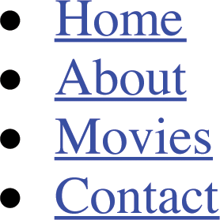

Slide 11
DIRECTORY
STRUCTURE
example
index.html
contact.html
portfolio
art.html
design.html
web.html
blog
blog.html
images
photo.jpg
  poster.gif
logo.gif
Notes:
Shows files used for a fictional site (compare to Finder / Windows explorer)
Home page, then sections about Movies, Music, and Theater
Movies has two sections: Cinema and DVD
Note: Folders often referred to as directories on server
Click: Root folder - folder that everything else sits inside
Click: Child folder
Click: Parent folder
Click: Granchild folder
Click: Grandparent folder
Note use of terms similar to those of a family tree

Slide 12
DIRECTORY
STRUCTURE
example
index.html
contact.html
portfolio
art.html
design.html
web.html
blog
blog.html
images
photo.jpg
  poster.gif
logo.gif
ROOT FOLDER
Notes:
Shows files used for a fictional site (compare to Finder / Windows explorer)
Home page, then sections about Movies, Music, and Theater
Movies has two sections: Cinema and DVD
Note: Folders often referred to as directories on server
Click: Root folder - folder that everything else sits inside
Click: Child folder
Click: Parent folder
Click: Granchild folder
Click: Grandparent folder
Note use of terms similar to those of a family tree

Slide 13
DIRECTORY
STRUCTURE
example
index.html
contact.html
portfolio
art.html
design.html
web.html
blog
blog.html
images
photo.jpg
  poster.gif
logo.gif
CHILD
Notes:
Shows files used for a fictional site (compare to Finder / Windows explorer)
Home page, then sections about Movies, Music, and Theater
Movies has two sections: Cinema and DVD
Note: Folders often referred to as directories on server
Click: Root folder - folder that everything else sits inside
Click: Child folder
Click: Parent folder
Click: Granchild folder
Click: Grandparent folder
Note use of terms similar to those of a family tree

Slide 14
DIRECTORY
STRUCTURE
example
index.html
contact.html
portfolio
art.html
design.html
web.html
blog
blog.html
images
photo.jpg
  poster.gif
logo.gif
CHILD
PARENT
Notes:
Shows files used for a fictional site (compare to Finder / Windows explorer)
Home page, then sections about Movies, Music, and Theater
Movies has two sections: Cinema and DVD
Note: Folders often referred to as directories on server
Click: Root folder - folder that everything else sits inside
Click: Child folder
Click: Parent folder
Click: Granchild folder
Click: Grandparent folder
Note use of terms similar to those of a family tree

Slide 15
DIRECTORY
STRUCTURE
example
index.html
contact.html
portfolio
art.html
design.html
web.html
blog
blog.html
images
photo.jpg
  poster.gif
logo.gif
CHILD
PARENT
GRANDCHILD
Notes:
Shows files used for a fictional site (compare to Finder / Windows explorer)
Home page, then sections about Movies, Music, and Theater
Movies has two sections: Cinema and DVD
Note: Folders often referred to as directories on server
Click: Root folder - folder that everything else sits inside
Click: Child folder
Click: Parent folder
Click: Granchild folder
Click: Grandparent folder
Note use of terms similar to those of a family tree

Slide 16
DIRECTORY
STRUCTURE
example
index.html
contact.html
portfolio
art.html
design.html
web.html
blog
blog.html
images
photo.jpg
  poster.gif
logo.gif
CHILD
PARENT
GRANDCHILD
GRANDPARENT
Notes:
Shows files used for a fictional site (compare to Finder / Windows explorer)
Home page, then sections about Movies, Music, and Theater
Movies has two sections: Cinema and DVD
Note: Folders often referred to as directories on server
Click: Root folder - folder that everything else sits inside
Click: Child folder
Click: Parent folder
Click: Granchild folder
Click: Grandparent folder
Note use of terms similar to those of a family tree

Slide 17
RELATIVE URLS
Linking from index.html to
example
index.html
contact.html
portfolio
art.html
design.html
web.html
blog
blog.html
images
photo.jpg
  poster.gif
logo.gif
Notes:
Shows the same directory structure as previous slide, but this time shows the relative URL
Click: Same folder - from music home page to music reviews page
Click: Child - from main home page to music listings page
Click: Parent - from music listings to main home page
Click: Grandchild - from main home page to DVD reviews page
Click: Grandparent: from DVD reviews to main home page

Slide 18
RELATIVE URLS
Linking from index.html to
example
index.html
contact.html
portfolio
art.html
design.html
web.html
blog
blog.html
images
photo.jpg
  poster.gif
logo.gif
SAME
contact.html
<a href=”contact.html">contact</a>
Notes:
Shows the same directory structure as previous slide, but this time shows the relative URL
Click: Same folder - from music home page to music reviews page
Click: Child - from main home page to music listings page
Click: Parent - from music listings to main home page
Click: Grandchild - from main home page to DVD reviews page
Click: Grandparent: from DVD reviews to main home page

Slide 19
RELATIVE URLS
Linking from index.html to
example
index.html
contact.html
portfolio
art.html
design.html
web.html
blog
blog.html
images
photo.jpg
  poster.gif
logo.gif
CHILD
portfolio/art.html
<a href=”portfolio/art.html">art</a>
Notes:
Shows the same directory structure as previous slide, but this time shows the relative URL
Click: Same folder - from music home page to music reviews page
Click: Child - from main home page to music listings page
Click: Parent - from music listings to main home page
Click: Grandchild - from main home page to DVD reviews page
Click: Grandparent: from DVD reviews to main home page

Slide 20
RELATIVE URLS
Linking from index.html to
example
index.html
contact.html
portfolio
art.html
design.html
web.html
blog
blog.html
images
photo.jpg
  poster.gif
logo.gif
PARENT
../index.html
<a href=”../index.html">home</a>
Notes:
Shows the same directory structure as previous slide, but this time shows the relative URL
Click: Same folder - from music home page to music reviews page
Click: Child - from main home page to music listings page
Click: Parent - from music listings to main home page
Click: Grandchild - from main home page to DVD reviews page
Click: Grandparent: from DVD reviews to main home page

Slide 21
RELATIVE URLS
Linking from index.html to
example
index.html
contact.html
portfolio
art.html
design.html
web.html
blog
blog.html
images
photo.jpg
  poster.gif
logo.gif
GRANDCHILD
portfolio/blog/blog.html
<a href=”portfolio/blog/blog.html">blog</a>
Notes:
Shows the same directory structure as previous slide, but this time shows the relative URL
Click: Same folder - from music home page to music reviews page
Click: Child - from main home page to music listings page
Click: Parent - from music listings to main home page
Click: Grandchild - from main home page to DVD reviews page
Click: Grandparent: from DVD reviews to main home page

Slide 22
RELATIVE URLS
Linking from index.html to
example
index.html
contact.html
portfolio
art.html
design.html
web.html
blog
blog.html
images
photo.jpg
  poster.gif
logo.gif
GRANDPARENT
../../index.html
/index.html
<a href=”/index.html">home</a>
Notes:
Shows the same directory structure as previous slide, but this time shows the relative URL
Click: Same folder - from music home page to music reviews page
Click: Child - from main home page to music listings page
Click: Parent - from music listings to main home page
Click: Grandchild - from main home page to DVD reviews page
Click: Grandparent: from DVD reviews to main home page

Slide 23
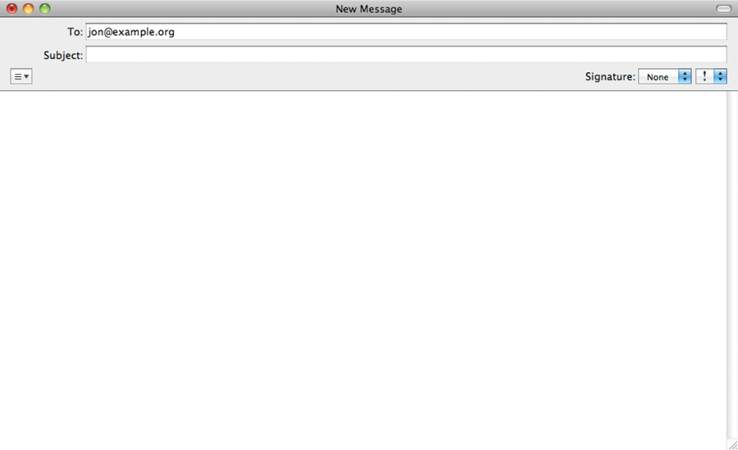
EMAIL LINKS
<a href="mailto:jon@example.org">Email Jon
</a>
Notes:
Click: highlights the mailto: before email address

Slide 24
EMAIL LINKS
<a href="mailto:jon@example.org
?cc=lindsey@example.org">Email Jon
</a>
<a href="mailto:jon@example.org
?subject=hello">Email Jon
</a>
Notes:
Click: highlights the mailto: before email address

Slide 25
EMAIL LINKS
<a href="mailto:jon@example.org
?body=Have a great day.">Email Jon
</a>
<a href="mailto:jon@example.org
?cc=lindsey@example.org
?subject=hello
?body=Have a great day.">Email Jon
</a>
Notes:
Click: highlights the mailto: before email address

Slide 26
TELEPHONE LINKS
<a href=”tel:18005552222">800-555-2222
</a>
Notes:
Click: highlights the mailto: before email address

Slide 27
OPENING LINKS IN NEW WINDOW WITH TARGET ATTRIBUTE
<a href="http://www.imdb.com"
target="_blank">IMDB</a> (opens in a
new window)
Notes:
Click: highlights target="_blank"
Note: tell users when link opens in a new window

Slide 28
OPENING LINKS IN NEW WINDOW WITH TARGET ATTRIBUTE
<a href="http://www.imdb.com"
target="_blank">Internet Movie
Database</a> (opens in a new window)
_self: Opens in same frame, default.
_top: Opens in the full body of window.
Notes:
Click: highlights target="_blank"
Note: tell users when link opens in a new window

Slide 29
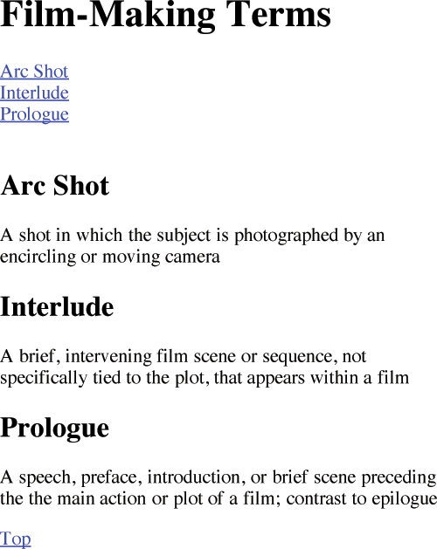
LINKING TO A SPECIFIC PART OF
THE SAME PAGE
Identify the destination (id attribute, #) and link to the id.
<h1 id="top">
Film-Making Terms</h2>
<a href="#arc-shot">
Arc shot</a><br />
<a href="#interlude">
Interlude</a><br />
<a href="#prologue">
Prologue</a><br />
<h2 id="prologue">
Prologue</h2>
<a href="#top">Top</a>
Notes:
Explain: on a long page you can link from one part of page to another
Typical use = back to top links at bottom of pages and links from content at top of page to lower part
Click: Arrow indicates clicking on prologue link takes you to that part of the page (content page will scroll down)
Highlighting indicates how the link relates to the element with the corresponding id attribute
Click: Arrow points to clicking on Top link, page scrolls back up
Highlighting shows how the link relates to the element with the corresponding id attribute
Note: The value of the id attribute must be unique to that page
Must start with letter or underscore (not a number)

Slide 30
LINKING TO A SPECIFIC PART OF
THE SAME PAGE
Identify the destination (id attribute, #) and link to the id.
<h1 id="top">
Film-Making Terms</h2>
<a href="#arc-shot">
Arc shot</a><br />
<a href="#interlude">
Interlude</a><br />
<a href="#prologue">
Prologue</a><br />
<h2 id="prologue">
Prologue</h2>
<a href="#top">Top</a>
<h1 id="top">
Film-Making Terms</h2>
<a href="#arc-shot">
Arc shot</a><br />
<a href="#interlude">
Interlude</a><br />
<a href="#prologue">
Prologue</a><br />
<h2 id="prologue">
Prologue</h2>
<a href="#top">Top</a>
Notes:
Explain: on a long page you can link from one part of page to another
Typical use = back to top links at bottom of pages and links from content at top of page to lower part
Click: Arrow indicates clicking on prologue link takes you to that part of the page (content page will scroll down)
Highlighting indicates how the link relates to the element with the corresponding id attribute
Click: Arrow points to clicking on Top link, page scrolls back up
Highlighting shows how the link relates to the element with the corresponding id attribute
Note: The value of the id attribute must be unique to that page
Must start with letter or underscore (not a number)

Slide 31
LINKING TO A SPECIFIC PART OF
THE SAME PAGE
Identify the destination (id attribute, #) and link to the id.
<h1 id="top">
Film-Making Terms</h2>
<a href="#arc-shot">
Arc shot</a><br />
<a href="#interlude">
Interlude</a><br />
<a href="#prologue">
Prologue</a><br />
<h2 id="prologue">
Prologue</h2>
<a href="#top">Top</a>
<h1 id="top">
Film-Making Terms</h2>
<a href="#arc-shot">
Arc shot</a><br />
<a href="#interlude">
Interlude</a><br />
<a href="#prologue">
Prologue</a><br />
<h2 id="prologue">
Prologue</h2>
<a href="#top">Top</a>
<h1 id="top">
Film-Making Terms</h2>
<a href="#arc-shot">
Arc shot</a><br />
<a href="#interlude">
Interlude</a><br />
<a href="#prologue">
Prologue</a><br />
<h2 id="prologue">
Prologue</h2>
<a href="#top">Top</a>
Notes:
Explain: on a long page you can link from one part of page to another
Typical use = back to top links at bottom of pages and links from content at top of page to lower part
Click: Arrow indicates clicking on prologue link takes you to that part of the page (content page will scroll down)
Highlighting indicates how the link relates to the element with the corresponding id attribute
Click: Arrow points to clicking on Top link, page scrolls back up
Highlighting shows how the link relates to the element with the corresponding id attribute
Note: The value of the id attribute must be unique to that page
Must start with letter or underscore (not a number)

Slide 32
LINKING TO A SPECIFIC PART OF
THE SAME PAGE
Identify the destination (id attribute, #) and link to the id.
<h1 id="top">
Film-Making Terms</h2>
<a href="#arc-shot">
Arc shot</a><br />
<a href="#interlude">
Interlude</a><br />
<a href="#prologue">
Prologue</a><br />
<h2 id="prologue">
Prologue</h2>
<a href="#top">Top</a>
<h1 id="top">
Film-Making Terms</h2>
<a href="#arc-shot">
Arc shot</a><br />
<a href="#interlude">
Interlude</a><br />
<a href="#prologue">
Prologue</a><br />
<h2 id="prologue">
Prologue</h2>
<a href="#top">Top</a>
Notes:
Explain: on a long page you can link from one part of page to another
Typical use = back to top links at bottom of pages and links from content at top of page to lower part
Click: Arrow indicates clicking on prologue link takes you to that part of the page (content page will scroll down)
Highlighting indicates how the link relates to the element with the corresponding id attribute
Click: Arrow points to clicking on Top link, page scrolls back up
Highlighting shows how the link relates to the element with the corresponding id attribute
Note: The value of the id attribute must be unique to that page
Must start with letter or underscore (not a number)

Slide 33
LINKING TO A SPECIFIC PART OF
THE SAME PAGE
Identify the destination (id attribute, #) and link to the id.
<h1 id="top">
Film-Making Terms</h2>
<a href="#arc-shot">
Arc shot</a><br />
<a href="#interlude">
Interlude</a><br />
<a href="#prologue">
Prologue</a><br />
<h2 id="prologue">
Prologue</h2>
<a href="#top">Top</a>
<h1 id="top">
Film-Making Terms</h2>
<a href="#arc-shot">
Arc shot</a><br />
<a href="#interlude">
Interlude</a><br />
<a href="#prologue">
Prologue</a><br />
<h2 id="prologue">
Prologue</h2>
<a href="#top">Top</a>
Notes:
Explain: on a long page you can link from one part of page to another
Typical use = back to top links at bottom of pages and links from content at top of page to lower part
Click: Arrow indicates clicking on prologue link takes you to that part of the page (content page will scroll down)
Highlighting indicates how the link relates to the element with the corresponding id attribute
Click: Arrow points to clicking on Top link, page scrolls back up
Highlighting shows how the link relates to the element with the corresponding id attribute
Note: The value of the id attribute must be unique to that page
Must start with letter or underscore (not a number)

Slide 34
LINKING FROM THE PAGE TO A SPOT ON ANOTHER PAGE
<a href="index.html#prologue">Prologue</a>
<h1 id="top">
Film-Making Terms</h2>
<a href="#arc-shot">
Arc shot</a><br />
<a href="#interlude">
Interlude</a><br />
<a href="#prologue">
Prologue</a><br />
<h2 id="prologue">
Prologue</h2>
<a href="#top">Top</a>
<h1 id="top">
Film-Making Terms</h2>
<a href="#arc-shot">
Arc shot</a><br />
<a href="#interlude">
Interlude</a><br />
<a href="#prologue">
Prologue</a><br />
<h2 id="prologue">
Prologue</h2>
<a href="#top">Top</a>
<h1 id="top">
Film-Making Terms</h2>
<a href="#arc-shot">
Arc shot</a><br />
<a href="#interlude">
Interlude</a><br />
<a href="#prologue">
Prologue</a><br />
<h2 id="prologue">
Prologue</h2>
<a href="#top">Top</a>
Notes:
Explain: on a long page you can link from one part of page to another
Typical use = back to top links at bottom of pages and links from content at top of page to lower part
Click: Arrow indicates clicking on prologue link takes you to that part of the page (content page will scroll down)
Highlighting indicates how the link relates to the element with the corresponding id attribute
Click: Arrow points to clicking on Top link, page scrolls back up
Highlighting shows how the link relates to the element with the corresponding id attribute
Note: The value of the id attribute must be unique to that page
Must start with letter or underscore (not a number)

Slide 35
IMAGE ELEMENT
SOURCE
ATTRIBUTE
<img src=”example.gif” alt=“Title”>
ALTERNATIVE
TEXT
ATTRIBUTE
Image Element: places image in the space.
Source Attribute: location of image.
Alternative Text Atribute: provides text if image is not available
Notes:
Shows the same directory structure as previous slide, but this time shows the relative URL
Click: Same folder - from music home page to music reviews page
Click: Child - from main home page to music listings page
Click: Parent - from music listings to main home page
Click: Grandchild - from main home page to DVD reviews page
Click: Grandparent: from DVD reviews to main home page

Slide 36
IMAGE ELEMENT
<img src=”example.gif” alt=“Title”
width="100" height="100">
WIDTH AND
HEIGHT
ATTRIBUTE
Width and Height Attribute, dimensions of the image, can speed up the time it takes to display the final page by seconds.
Notes:
Shows the same directory structure as previous slide, but this time shows the relative URL
Click: Same folder - from music home page to music reviews page
Click: Child - from main home page to music listings page
Click: Parent - from music listings to main home page
Click: Grandchild - from main home page to DVD reviews page
Click: Grandparent: from DVD reviews to main home page

Slide 37
ADDING IMAGES
<img src="images/photo.jpg" alt="brochure">
<img src="../../images/poster.gif" alt="brochure">
<img src="/images/logo.gif" alt="brochure">
Notes:
Click: highlights target="_blank"
Note: tell users when link opens in a new window

Slide 38
DIRECTORY
STRUCTURE
On index page adding photo.jpg from images folder
example
index.html
contact.html
portfolio
art.html
design.html
web.html
blog
blog.html
images
photo.jpg
  poster.gif
logo.gif
<img src=”images/photo.jpg” alt=“photo image”>
Notes:
Shows files used for a fictional site (compare to Finder / Windows explorer)
Home page, then sections about Movies, Music, and Theater
Movies has two sections: Cinema and DVD
Note: Folders often referred to as directories on server
Click: Root folder - folder that everything else sits inside
Click: Child folder
Click: Parent folder
Click: Granchild folder
Click: Grandparent folder
Note use of terms similar to those of a family tree

Slide 39
DIRECTORY
STRUCTURE
On blog page adding poster.gif from images folder
example
index.html
contact.html
portfolio
art.html
design.html
web.html
blog
blog.html
images
photo.jpg
  poster.gif
logo.gif
<img src=”../../images/poster.gif” alt=“poster image”>
Notes:
Shows files used for a fictional site (compare to Finder / Windows explorer)
Home page, then sections about Movies, Music, and Theater
Movies has two sections: Cinema and DVD
Note: Folders often referred to as directories on server
Click: Root folder - folder that everything else sits inside
Click: Child folder
Click: Parent folder
Click: Granchild folder
Click: Grandparent folder
Note use of terms similar to those of a family tree

Slide 40
DIRECTORY
STRUCTURE
On blog page adding logo.gif from images folder
example
index.html
contact.html
portfolio
art.html
design.html
web.html
blog
blog.html
images
photo.jpg
  poster.gif
logo.gif
<img src=”/images/logo.gif” alt=“logo image”>
Notes:
Shows files used for a fictional site (compare to Finder / Windows explorer)
Home page, then sections about Movies, Music, and Theater
Movies has two sections: Cinema and DVD
Note: Folders often referred to as directories on server
Click: Root folder - folder that everything else sits inside
Click: Child folder
Click: Parent folder
Click: Granchild folder
Click: Grandparent folder
Note use of terms similar to those of a family tree

Slide 41
TEXT VERSUS IMAGE LINKS
Search engines won’t know what certain parts of your site are about if images are used. In addition, images greatly increase the loading time of a page and are far more difficult to update when you make changes to your site. For these reasons, use image text sparingly. Such text usually appears in headers, in logos, or on buttons.
Notes:
Click: highlights target="_blank"
Note: tell users when link opens in a new window

